Slide 1
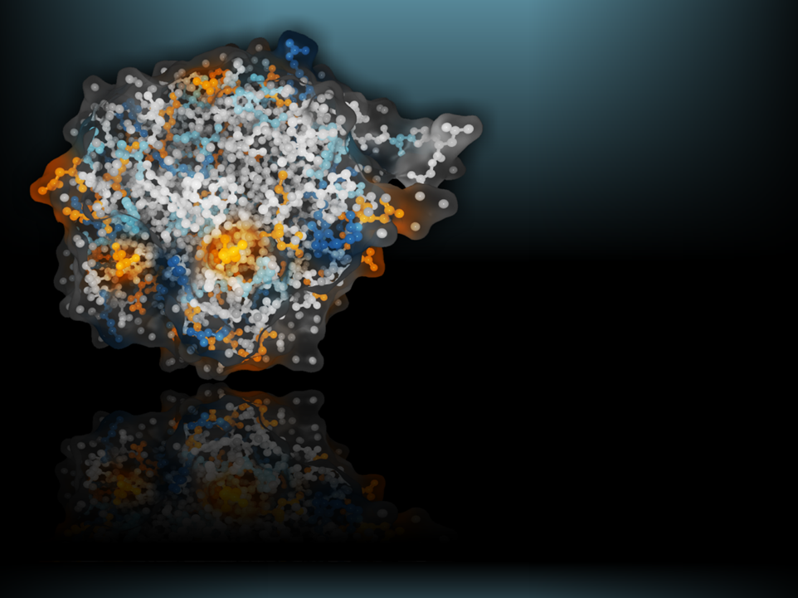
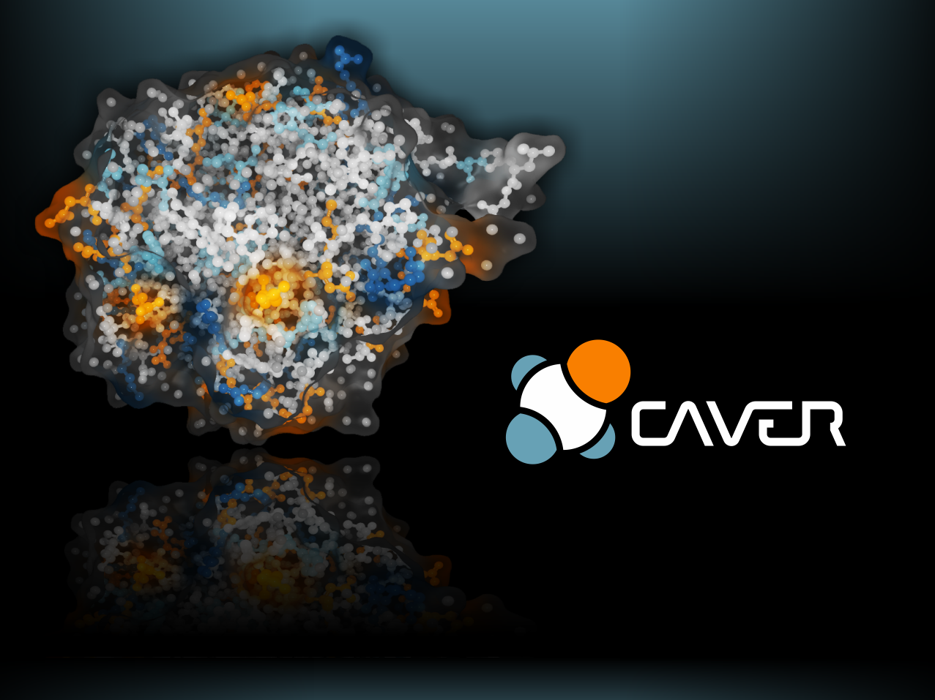
BUSINESS PLAN
Visualization
and Visual Analysis
of Proteins
and their Dynamics
GEOMETRICAL DETECTION OF
PATHWAYS IN PROTEIN STRUCTURES
LEADING AMONG MORE BINDING SITES
PROTEIN ANALYSIS AND VISUALIZATION
Barbora Kozlíková
VisIt Lab, FI MU
Barbora Kozlíková & Jiří Sochor
Masaryk University, Czech Republic
Ondřej Strnad et al., Masaryk University, Czech Republic
BIBE 2012 | 12. 11. 2012
www.caver.cz
Notes:
Thank you for your introduction and especially for the opportunity to present our research project and the resulting tool at this conference. In the next few minutes I would like to present the basic principles and functionality of our software tool for protein analysis and visualization called CAVER. This application is a result of long-term cooperation of researchers at Masaryk University in Brno in the Czech Republic.
1

Slide 2
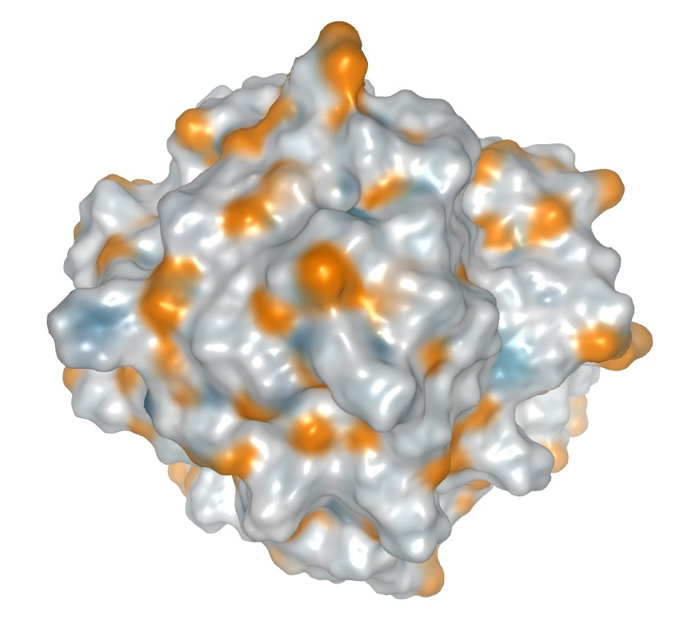
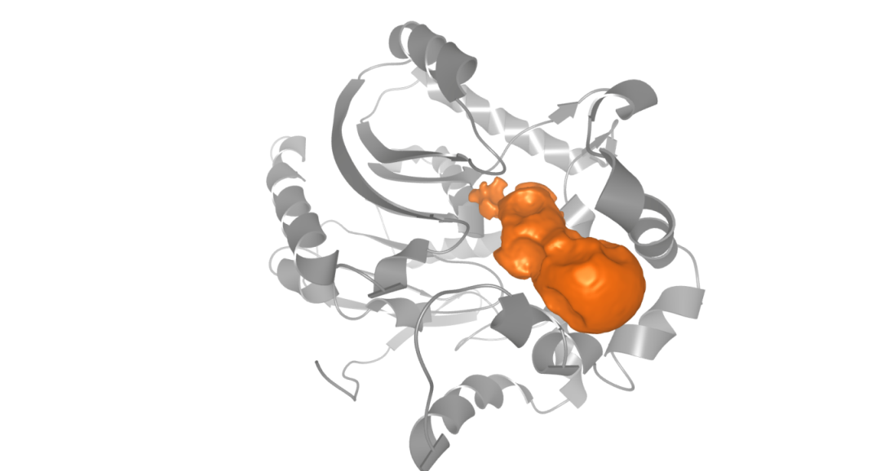
Motivation and Background
Geometrical analysis and visualization of proteins and their inner voids
CAVER and CAVER Analyst software tools
Notes:
In this talk I will mainly focus on methods for visual interactive exploration of protein tunnels which I have developed together with my colleagues.
These methods HELP to reveal tunnel geometry,
the physico chemical properties of their surroundings
and molecular dynamics.
They can be used for instance to EVALUATE or modify the reactivity of the protein (w.r.t.) other small molecules called ligands.

Slide 3
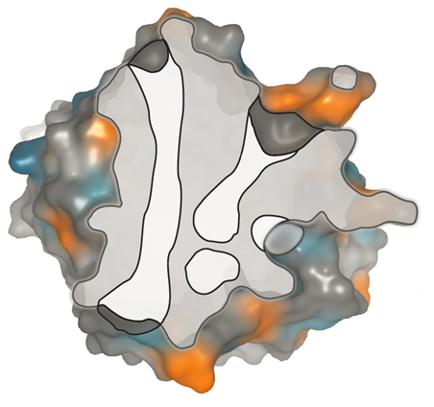
Importance of Protein Analysis
Understanding protein structure is essential in many fields
Structural biology
Drug design
Protein engineering
Notes:
In this talk I will mainly focus on methods for visual interactive exploration of protein tunnels which I have developed together with my colleagues.
These methods HELP to reveal tunnel geometry,
the physico chemical properties of their surroundings
and molecular dynamics.
They can be used for instance to EVALUATE or modify the reactivity of the protein (w.r.t.) other small molecules called ligands.

Slide 4
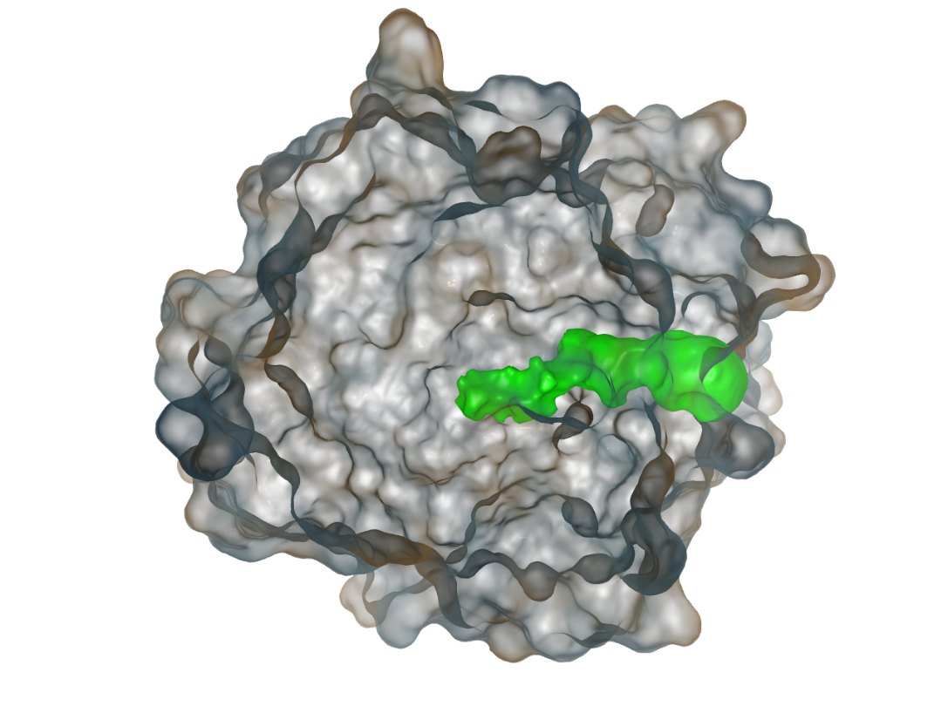
Tunnel Exploration
Tunnel geometry
Physico-chemical properties
Molecular dynamics
Protein – Ligand reactivity
Notes:
In this talk I will mainly focus on methods for visual interactive exploration of protein tunnels which I have developed together with my colleagues.
These methods HELP to reveal tunnel geometry,
the physico chemical properties of their surroundings
and molecular dynamics.
They can be used for instance to EVALUATE or modify the reactivity of the protein (w.r.t.) other small molecules called ligands.

Slide 5
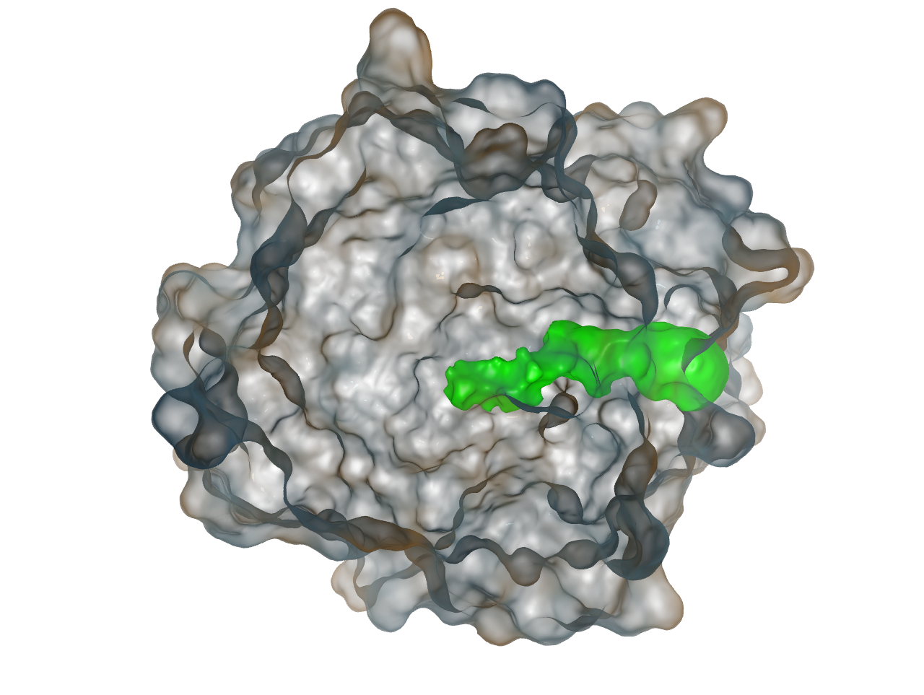
Protein – Ligand Interaction
Protein
Ligand
Active Site
Notes:
Back in Brno we cooperate with group of biochemist that are interested in protein engineering.
In principle, our domain experts look for PROPER combination of a protein and ligand which may lead to the desired reaction.
However, before such reaction can even occur the ligand has to reach the protein’s active site. By which we understand deaply burried cavity with reactive amino acids.
This active site is connected with outer environment by tunnels which serves as potential transport pathways for our ligand.

Slide 6
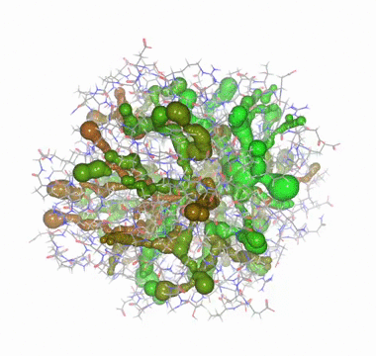
Data Complexity
Computation produces extensive number of tunnels
… which are moving over time
Notes:
Even though the each sw is using different method the common property of all these tools is that they produce the extensive amount of tunnels.
More over, tunnels are moving in time, which brings another level of complexity.

Slide 7
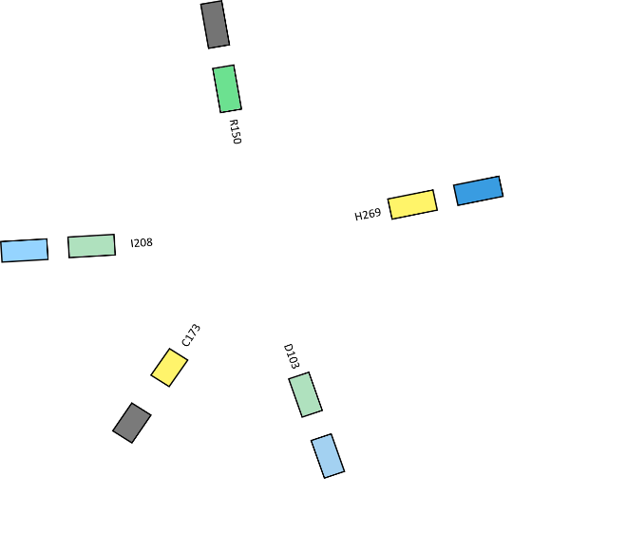
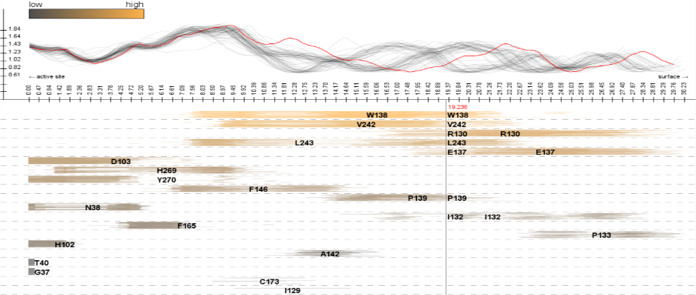
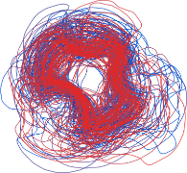
Proposed Solutions
Exploration of tunnel properties along and across its centerline over time
MoleCollar – exploration of tunnel bottleneck
AnimoAminoMiner – tunnel profile and its surroundings
Time

Slide 8
All Tunnel Heatmap
Time i
Bottleneck Size
Bottleneck Size Threshold
Time
Tunnel #4
Tunnel #1
Tunnel #
Notes:
Therefore we come with alternative visualization which we call ATH. It is actually a modification of a standard heat map.
In ATH, the X axis corresponds to the tunnel number while the Y axis represents time.
The tunnels are sorted by cost function provided by analysis tool used for their computation.
This way the user can scan horizontal lines to determine which tunnel was opened at specific time. While the vertical lines provide information whether the tunnel was open over the whole simulation or only for a small fraction of time and therefore it is unimportant.
The actual bottleneck size of the tunnel is encoded using color scale.
WHILE THE SIZE of the bottleneck which is below the user defined threshold at which he or she considers it closed is colored in white.
If we focus on a single tunnel – let say the first one - we can actually use the similar representation to see more details.

Slide 9
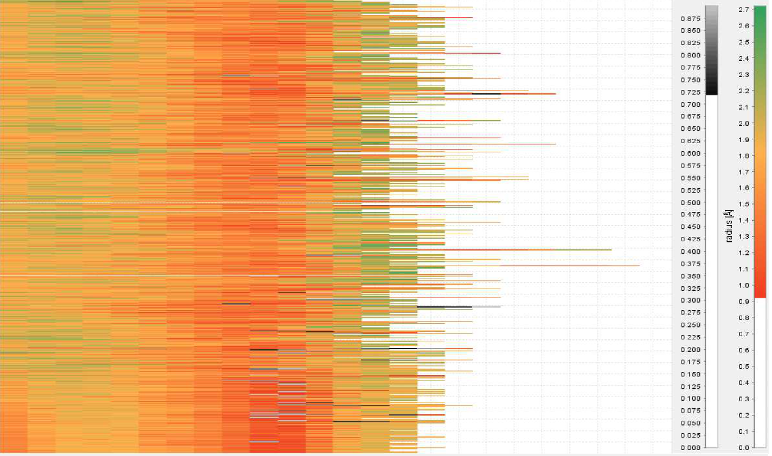
Single Tunnel Heatmap
Bottleneck Size
Time
Active Site
Molecular Surface
Tunnel Length
Threshold: 0.9 Å
Notes:
We call this STH
Here the main axis represents to the tunnel length while the part on left side (from your perspective) corresponds to the part of the tunnel inside the protein and the right side represents molecular surface
This way the biochemist can scan the horizontal lines to see where the tunnel bottleneck actually is with respect to tunnel length. He or she can even notice that there were actually two bottlenecks for a short period of time.
The size of the bottleneck is again represented by color scale, however, in this case we have decided to split it into two different scales according to user defined threshold.

Slide 10
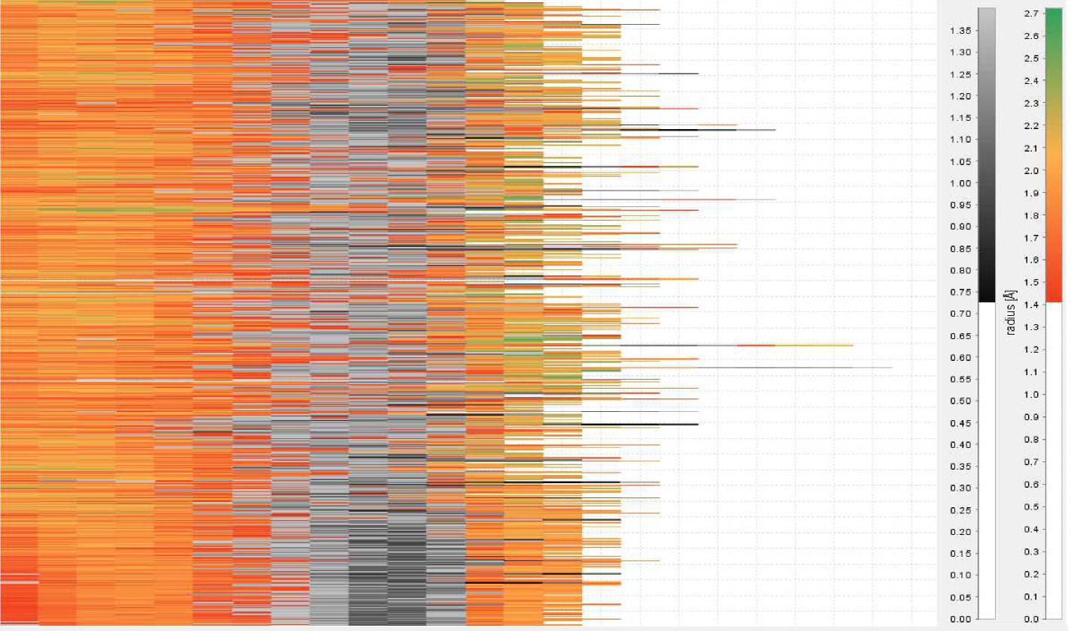
Single Tunnel Heatmap
Bottleneck Size
Time
time
Active Site
Molecular Surface
Tunnel Length
Threshold: 1.4 Å
Notes:
The gray scale helps to understand the size of the bottleneck event though the tunnel is closed.
The darker GRAY corresponds to the parts of the tunnel which are highly bellow the user selected threshold.

Slide 11
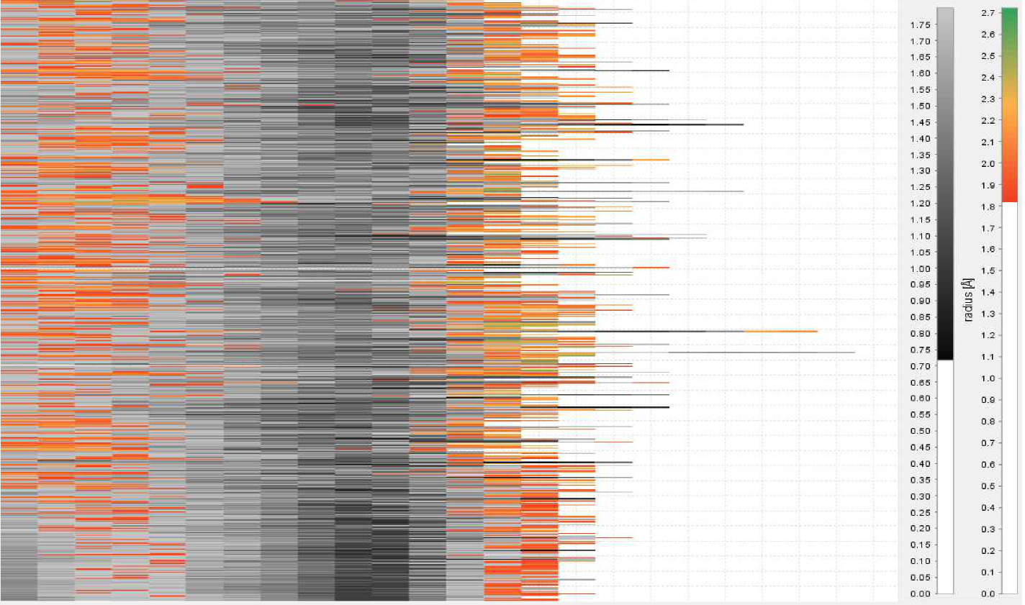
Single Tunnel Heatmap
Bottleneck Size
Time
time
Active Site
Molecular Surface
Tunnel Length
Threshold: 1.8 Å
Notes:
This way the visualization allows the biochemists to interactively filter out parts of the tunnel they consider to be inaccessible by given ligand size. And hence test the data for Protein-ligand compatibility with ligands of different sizes.
In this figure u can see the threshold value was set to high and the tunnel is almost completely closed.

Slide 12
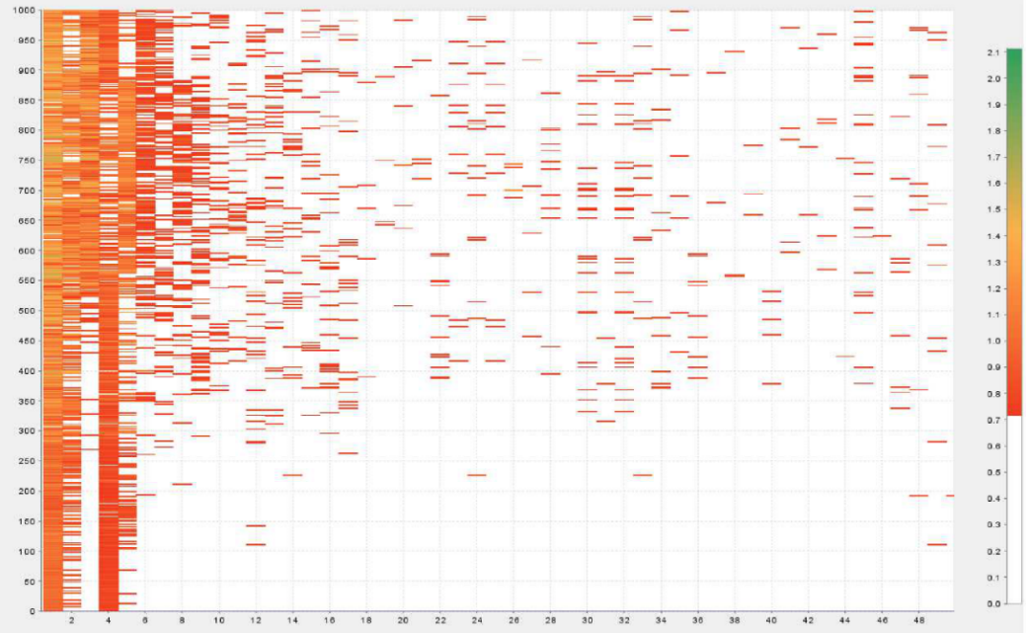
All vs. Single Tunnel Heatmaps
Enables filtering among many tunnels
Enables detailed exploration of single tunnel
Notes:
\Therefore ATH enables filtering among many tunnels and STH enables detailed exploration of single tunnel.

Slide 13
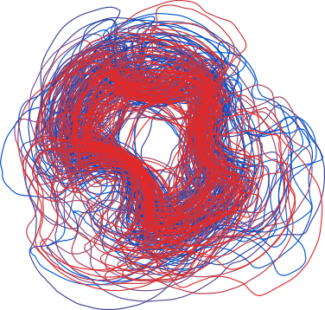
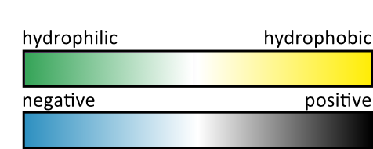
MoleCollar
Notes:
I will start with describing the front view first. We call this method MoleCollar because we explore the tunnel bottleneck (collar) within a molecule.

Slide 14
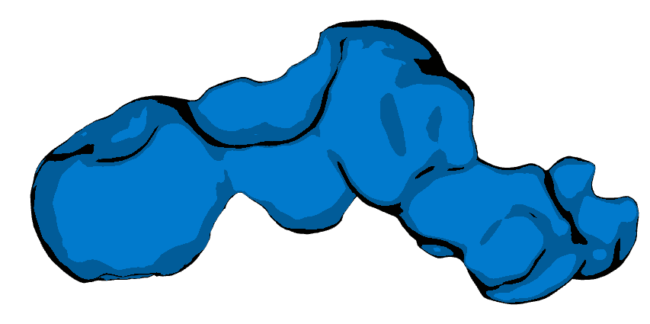
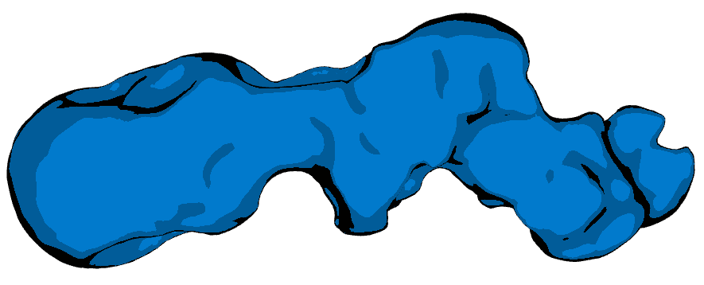
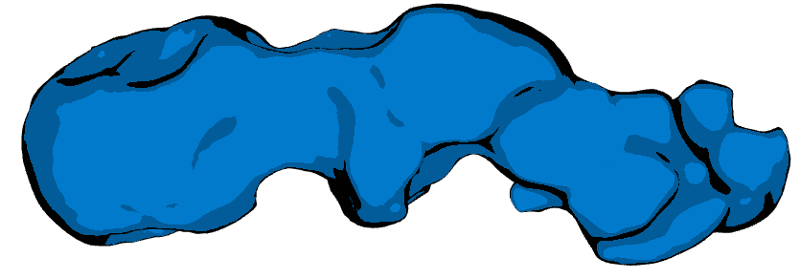
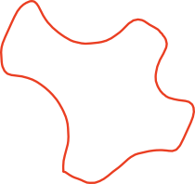
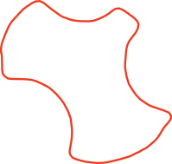
MoleCollar in Detail
t₁
t₂
t₃
Time
Notes:
The biochemist usually study the tunnel behavior over time.
In each such time step we can determine the tunnel centerline.
…. And cut the tunnel perpendicular to it in some particular place of interest - i.e., in the bottleneck. This way we obtain the contour shape of the tunnel for each time step.
The resulting contours are then aggregated over the whole simulation so ….

Slide 15
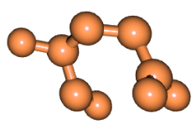
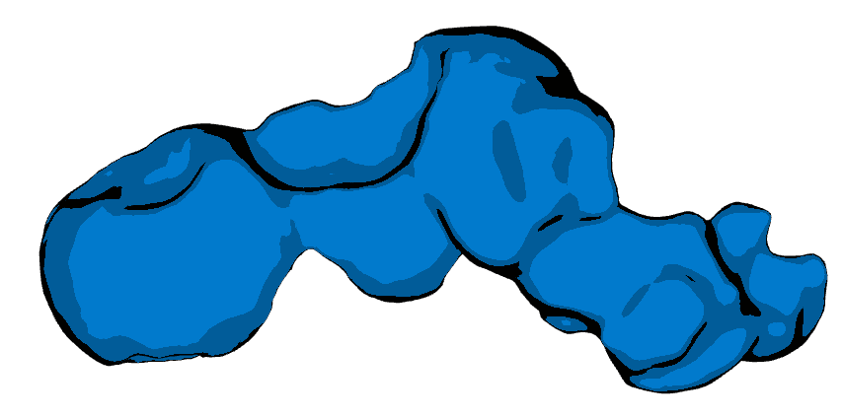
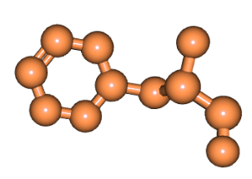
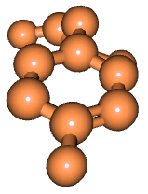
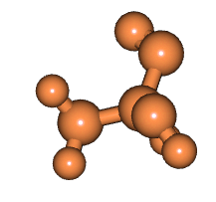
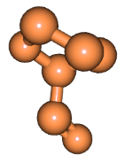
MoleCollar in Detail
Shape Stability over Time
Empty Space
Time
Notes:
… the user can immediately see the stability of the tunnel over time or the maximum empty space which is available during the whole simulation.
Moreover, the bottleneck shape is determined by the set of surrounding amino acids, which also carry its physicochemical properties….
We can map these AA to their corresponding places around our visualization … and directly render their properties.
Each property is rendered in single circle. In this manner we are able to add an arbitrary number of properties which is usually in this field limited to five at once
The size of the bar represents the time for which the property was presented in the simulation. While the actual value of the property is encoded using color scales.

Slide 16
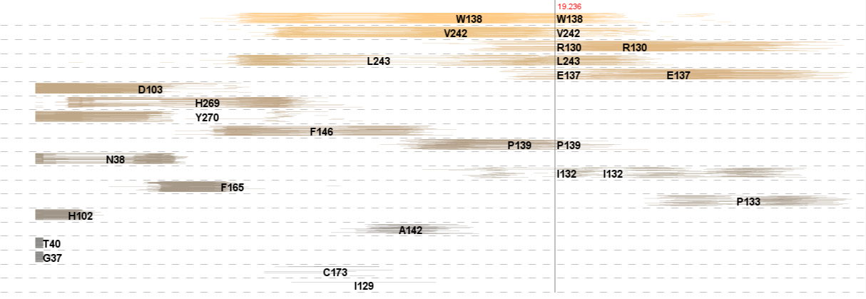
AnimoAminoMiner
TunProfile
AAExplorer
Notes:
The second visualization provides the overview of the tunnel along its centerline. We call this visualization the AnimoAminoMiner. It is multiview representation that consists of two parts.
The upper part is called TunProfile and the bottom part is called AAExplorer.

Slide 17
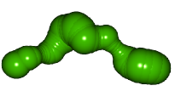
TunProfile
tunnel width
tunnel length
Notes:
The TunProfile focuses on the intuitive representation of tunnel
width and length and their changes over time.
The tunnel width is computed as the radius of the corresponding sphere in the tunnel representation.
While again the part closer to the active site is on the left side of the representation and part of the tunnel closer to the surface is on the right.

Slide 18
TunProfile in Detail
Notes:
The tunnel SHAPE is computed and its corresponding curve is plotted in each time step.
Which results in the aggregated view, that REVEALS the most stable and unstable parts of the tunnel.
The stable parts are represented by a dense packing as can be seen here.
With the TunProfile representation, the user can also easily detect tunnel bottlenecks and their positions along the tunnel centerline.

Slide 19
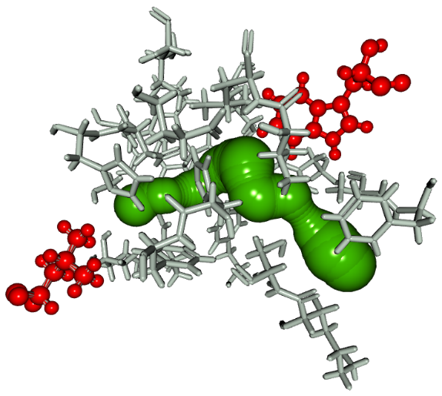
AAExplorer
Notes:
The bottom part of our method, called AAExplorer, on the other hand, provides users with the information about the amino acids surrounding the tunnel.

Slide 20
Line Representation
Single Time Step
Notes:
A single line in this representation corresponds to the influence region of one amino acid for a single time step.

Slide 21
AnimoAminoMiner Exploration
Notes:
The bottom part can be then colored using different biochemical properties – such as hydrophobicity, the amount at which the amino acid influence the tunnel and many others.
Note that in this view it is not possible to show more then one property at time, for this purpose the user should utilize the MoleCollar view or a detailed information window which I will show you in this video as well.

Slide 22
AnimoAminoMiner Exploration
Notes:
The biochemist can use a vertical slider to explore the surrounding amino acids wrt their distance from active site.

Slide 23
AnimoAminoMiner Exploration
Notes:
Our visualization also enables horizontal and vertical zooming in order to explore the contribution of individual amino acids in more detail.

Slide 24
AnimoAminoMiner Exploration
Notes:
Here you can see that the user can also obtain the detailed information about a single amino acid.

Slide 25
Detailed View
Notes:
This table provides various information.
At the top you can see the part of the amino acid chain or sequence where the AA belongs to.
Bellow the sequence you can find its biochemical properties.
The most important part, however, is the bottom one.
Here, you can find the contribution of this particular AA to other tunnels in the molecule as well. This is very helpfull in case the biochemist would like to exchange this AA in order to change the behavior of the protein in some way – here they can immediately see, which tunnel will be affected as well and can decide whether this change is desired or not.

Slide 26
AnimoAminoMiner Exploration
Notes:
In case the biochemists want to focus on a smaller time span or particular future, our visualization allows to select a desired set of tunnel curves by a rectangle. The selected set or all other remaining curves are then filter out.

Slide 27
AnimoAminoMiner Exploration
Notes:
The amino acids may be filtered in similar manner as well. The user can define a threshold for each criterion and filter out the amino acids bellow or above this threshold.

Slide 28
AnimoAminoMiner Exploration
Notes:
The same criteria can be also used to sort the amino acids.

Slide 29
AnimoAminoMiner Exploration
Notes:
And finally both MoleCollar visualization and AnimoAminoMiner are linked together so the biochemist can for instance select a particular place of interest using vertical slider in AAM and the corresponding contours are computed automatically.

Slide 30
Results
Tested and evaluated by domain experts
Protein and metabolic engineering laboratory from the Masaryk University
Details in:
Byška et al, MoleCollar and Tunnel Heat Map Visualizations for Conveying Spatio-Temporo-Chemical Properties Across and Along Protein Voids, Computer Graphics Forum, 3(34):1-10, 2015
Byška et al, AnimoAminoMiner: Exploration of Protein Tunnels and their Properties in Molecular Dynamics, IEEE TVCG, DOI 10.1109/TVCG.2015.2467434, 2015
Notes:
All method I have show you today was tested and evaluated by domain experts from …….. I will show you one of the studies we have performed that tests all three our methods at the same time. We have actually used the existing study on a protein from the family of Haloalkane dehalogenases where the main goal was to increase the resistance of the molecule to organic cosolvents.
It basically means that biochemists needed to mutate the protein in order to close its main tunnel.

Slide 31
CAVER Analyst
www.caver.cz
Notes:
So this brings me basically to the end of my presentation.
I have shown you some novel techniques for filtering and exploration of protein tunnel w.r.t. to protein – ligand interactions.
What we consider for the future work is to include an intuitive way to visualize or animate of ligand passing through the tunnel.
And also we would like to focus on greater scale.
Here we have two approaches in mind – We are currently working on an abstract visualizations of the whole molecule which would enabled to intuitively compare similar molecules i.e., from one protein family.
And also we are trying to develop some techniques for visualization of protein-protein interactions.

Slide 32
Conclusion
Proposed visualizations enable the domain experts to:
Find the most biologically relevant tunnel(s)
Explore its bottleneck and the surrounding amino acids
Explore the tunnel profile with all surrounding amino acids
Fast and comprehensible detection of amino acids which are candidates for protein mutation
Notes:
So this brings me basically to the end of my presentation.
I have shown you some novel techniques for filtering and exploration of protein tunnel w.r.t. to protein – ligand interactions.
What we consider for the future work is to include an intuitive way to visualize or animate of ligand passing through the tunnel.
And also we would like to focus on greater scale.
Here we have two approaches in mind – We are currently working on an abstract visualizations of the whole molecule which would enabled to intuitively compare similar molecules i.e., from one protein family.
And also we are trying to develop some techniques for visualization of protein-protein interactions.

Slide 33
What is the next step?
Exploration and guided navigation within large MD simulations and their ensembles
Exploration of many different properties – helps to understand the significance of a given part of the trajectory
Comparative visualization
Notes:
So this brings me basically to the end of my presentation.
I have shown you some novel techniques for filtering and exploration of protein tunnel w.r.t. to protein – ligand interactions.
What we consider for the future work is to include an intuitive way to visualize or animate of ligand passing through the tunnel.
And also we would like to focus on greater scale.
Here we have two approaches in mind – We are currently working on an abstract visualizations of the whole molecule which would enabled to intuitively compare similar molecules i.e., from one protein family.
And also we are trying to develop some techniques for visualization of protein-protein interactions.

Slide 34
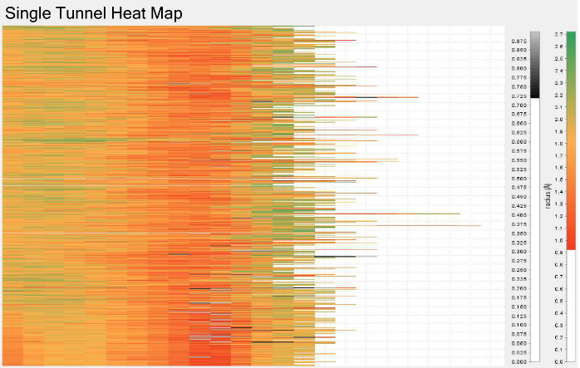
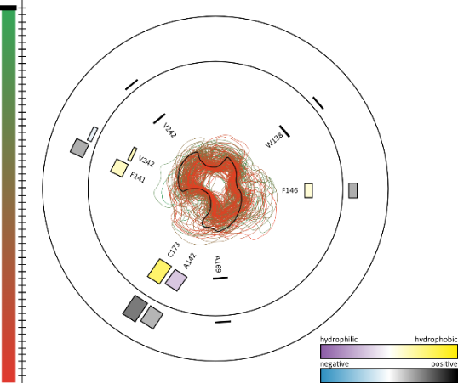
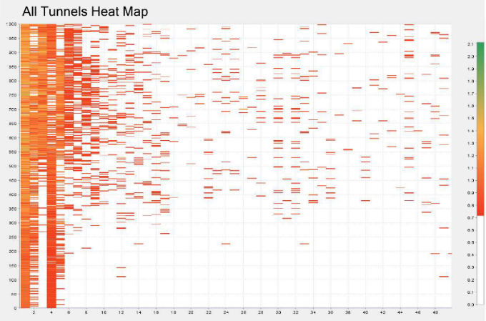
Thank You for Your Attention
Acknowledgement:
Jan Byška, Adam Jurčík, Ivan Viola, Mathieu Le Muzic, Eduard M. Gröller
Notes:
At the and I would like to acknowledge all my colleagues that participated on the mentioned visualizations.
With that being said, I would also like to thank you for your attention and if you have any questions feel free to ask.

